Slide 1


BMB3015 ARTIFICIAL INTELLIGENCE
ADVERSARIAL SEARCH
(GAME PLAYING)

Slide 2
Outline
Games
Optimal decisions
minimax algorithm
α-β pruning
Resource limits and approximate evaluation
Nondeterministic games
Expectiminimax algorithm

Slide 3
Why Study Games?
Clear criteria for success
Offer an opportunity to study problems involving hostile, adversarial, competing agents.
Historical reasons
Fun
Interesting, hard problems which require minimal “initial structure”
Games often define very large search spaces
chess 35¹⁰⁰ nodes in search tree, 10⁴⁰ legal states

Slide 4
Games
Multiagent environments
any given agent will need to consider the actions of other agents and how they affect its own welfare
The unpredictability of these other agents can introduce many possible contingencies
There could be competitive or cooperative environments
Competitive environments, in which the agents’ goals are in conflict require adversarial search
these problems are called as games

Slide 5
Games
In game theory (economics),
any multiagent environment (either cooperative or competitive) is a game provided that the impact of each agent on the other is significant
AI games are a specialized kind
deterministic, turn taking, two-player, zero sum games of perfect information
Therefore in this context games are assumed to be
deterministic, fully observable environments
with two agents whose actions alternate
and the utility values at the end are always equal and opposite (+1 and –1)

Slide 6
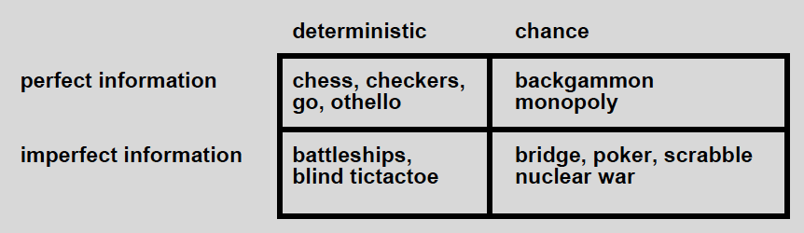
Types of Games
Backgammon
Involves randomness, i.e. dice rolls
Machine learning-based player could draw the world champion human player.
Computer players are better today with advanced technologies.
Bridge
Involves hidden information, i.e. other players’ cards and communication during bidding
Computer players play well but may not bid well.
Go
No new elements but huge branching factor
Deep reinforcement learning-based player (AlphaGo) could defeat champion human player
Notes:
Bidding: fiyat teklifi verme

Slide 7
A Typical AI Game
2-player game
Players alternate moves
Zero-sum: one player’s loss is the other’s gain
Perfect information:
both players have access to complete information about the state of the game.
No information is hidden from either player.
No chance (e.g., using dice) involved
Examples:
Tic-Tac-Toe, Checkers, Chess, Go, Nim, Othello
Not a typical game:
Bridge, Solitaire, Backgammon, ...

Slide 8
How to Play A Game?
A way to play such a game is to
Consider all the legal moves you can make
Compute the new position resulting from each move
Evaluate each resulting position and determine which is best
Make that move
Wait for your opponent to move and repeat
Key problems are
Representing the “board”
Generating all legal next boards
Evaluating a position

Slide 9
How an Agent can Play a Game?
Abstraction
To describe a game we must capture every relevant aspect of the game such as
Chess, tic-tac-toe, …
Accessible environments
Such games are characterized by perfect information
Search
Game playing then consists of a search through possible board configurations
Unpredictable opponent
introduces uncertainty thus game-playing must deal with contingency problems

Slide 10
Games vs. Search Problems
"Unpredictable" opponent
requires specifying a move for every possible opponent reply
Time limits
unlikely to find goal, must approximate

Slide 11
Game Trees
A game formulated as a search problem
Initial state: board position and player turn
Operators: definition of legal moves
Terminal state: conditions for when game is over
Utility function: a numeric value that is assigned to states and describes the
outcome of the game.
e.g., -1, 0, 1 for loss, draw, win.
Game tree: encodes all possible games
We are not looking for a path but only the next move to make (that hopefully leads to a winning position)
Our best move depends on what the other player does

Slide 12
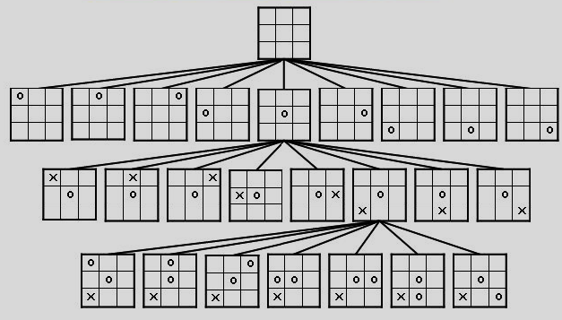
Partial Game Tree for Tic-Tac-Toe

Slide 13
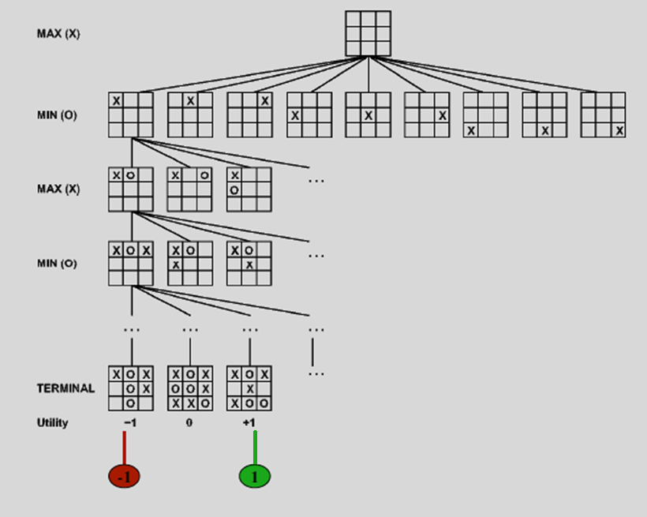
Game Tree
2-player
deterministic
alternating moves

Slide 14
Searching for the Next Move
Complexity: many games have a huge search space
Chess: b = 35, m = 100 nodes = 35 ¹⁰⁰
if each node takes about 1 ns to explore then each move will take about 10¹³⁴ millenniums to calculate.
Resource (e.g., time, memory) limit: optimal solution not feasible/possible, thus must approximate
Pruning: makes the search more efficient by discarding portions of the search tree that obviously cannot improve quality of result.
Evaluation functions: heuristics to evaluate utility of a state without exhaustive search.

Slide 15
Optimal Strategies
In a normal search problem, the optimal solution would be
a sequence of moves leading to a goal (terminal) state that is a win
In a game, MIN has something to say about it and therefore MAX must find a contingent strategy, which specifies
– MAX’s move in the initial state,
– then MAX’s moves in the states resulting from every possible response by MIN,
– then MAX’s moves in the states resulting from every possible response by MIN to those moves
– …
An optimal strategy leads to outcomes at least as good as any other strategy when one is playing an infallible opponent
Notes:
Contingent: muhtemel, olası, beklenmedik durum

Slide 16
Minimax
Perfect play for deterministic games
Idea: choose move to position with highest minimax value = best achievable payoff against best play
Minimax procedure
Generate start node as a MAX node with current board configuration
Expand nodes down to some depth (a.k.a. ply) of lookahead in the game
Apply the evaluation function at each of the leaf nodes
“Back up” values for each of the non-leaf nodes until a value is computed for the root node
At MIN nodes, the backed-up value is the minimum of the values associated with its children.
At MAX nodes, the backed-up value is the maximum of the values associated with its children.
Pick the operator associated with the child node whose backed-up value determined the value at the root
Notes:
Payoff: ödünleşme, ödül veya ceza
Minimax value
Given a game tree, the optimal strategy can be determined by examining the minimax value of each node (MINIMAX-VALUE(n))
The minimax value of a node is the utility of being in the corresponding state, assuming that both players play optimally from there to the end of the game
Given a choice, MAX prefer to move to a state of maximum value, whereas MIN prefers a state of minimum value

Slide 17
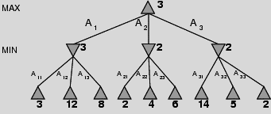
Minimax 2-Ply Game
MINIMAX-VALUE(root)=
max(min(3,12,8), min(2,4,6), min(14,5,2)) =
max(3,2,2)= 3
MAX node
value computed
by minimax
MIN node
MIN node
MIN node
Leaf nodes
f value

Slide 18
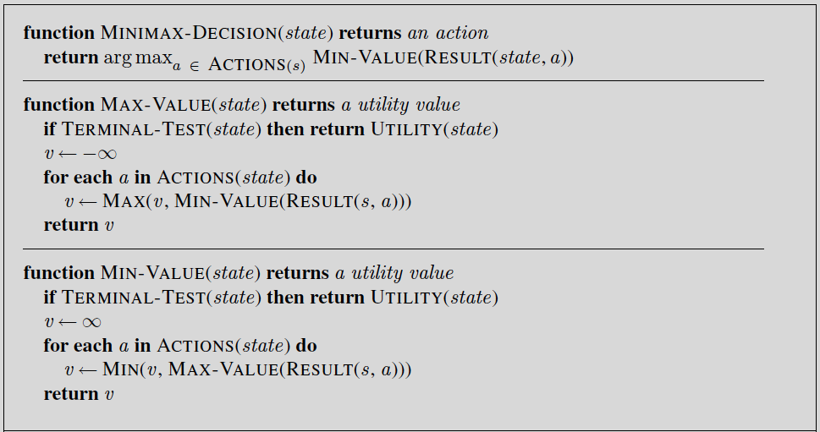
Minimax Algorithm
Notes:
Minimax bileşenleri
MAX = Bizim olası hamlelerimizden kendi açımızdan en iyi sonucu verenin seçilmesi
MIN = Rakibin olası hamlelerinden kendi açısından en iyi sonucu veren, bizim açımızdan en kötü sonucu verenin seçilmesi
UTILITY = Oyunun sonucunu gösteren durum (Ör: kazanırsak +1, berabere 0, kaybedersek -1)
MINIMAX-VALUE(n) =
UTILITY(n) eğer n oyun sonu seviyesinde ise
max ( Ardıl (n) ) eğer n MAX seviyesinde ise
min ( Ardıl (n) ) eğer n MIN seviyesinde ise
Ardıl (n) = n durumundan gidilebilecek tüm durumların değerleri

Slide 19
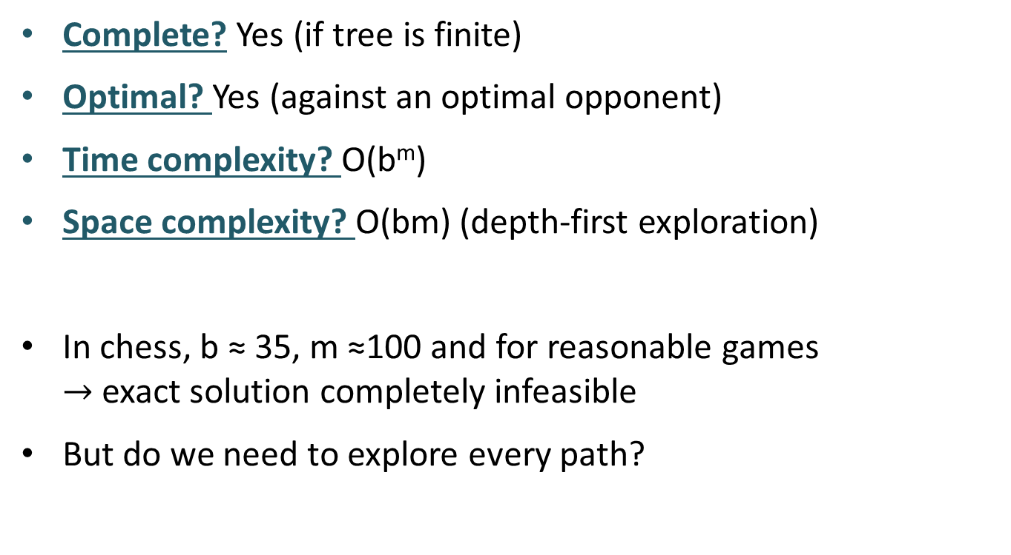
Properties of Minimax
Complete? Yes (if tree is finite)
Optimal? Yes (against an optimal opponent)
Time complexity? O(b^{m})
Space complexity? O(bm) (depth-first exploration)
In chess, b ≈ 35, m ≈100 and for reasonable games $→$ exact solution completely infeasible
But do we need to explore every path?
Notes:
Complete?? Only if tree is finite (chess has specific rules for this).
NB a finite strategy can exist even in an infinite tree!

Slide 20
Evaluation of the Moves without Complete Search
Complete search is too complex and impractical
Evaluation function: evaluates value of state using heuristics and cuts off search
Modified MINIMAX:
CUTOFF-TEST: cutoff test to replace the termination condition (e.g., deadline, depth-limit, etc.)
EVAL: evaluation function to replace utility function (e.g., number of chess pieces taken)

Slide 21
Cutting off Search
MinimaxCutoff is identical to MinimaxValue except
Use cutoff test instead of terminal test
e.g., Terminal? is replaced by Cutoff? (Depth limit)
Use evaluation function instead of utility
= evaluation function estimates desirability of position
e.g., Utility is replaced by Eval

Slide 22
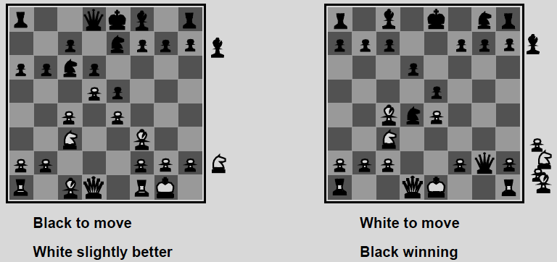
Evaluation Functions
Weighted linear evaluation function: to combine n heuristics
f = w₁.f₁ + w₂.f₂ + … + w_{n}.f_{n}
w’s could be the values of pieces
1 for pawn, 3 for bishop, or 9 for queen etc.
f’s could be the number of pieces of that type on the board
f₁(s) = (number of white pawns) – (number of black pawns)
Notes:
Oyunun sonucunun çok derinlerde olduğu durumlarda durumların değerlendirilmesi için kullanılan fonksiyonlardır.
Satranç için bu fonksiyon genellikle önceden belirlenen özniteliklerin doğrusal toplamı olarak düşünülür.
Eval(s) = w₁ f₁(s) + w₂ f₂(s) + … + w_{n} f_{n}(s)
Örnek, w₁ = 9 ve
f₁(s) = (beyaz vezir sayısı) – (siyah vezir sayısı), vs.
Ağırlıklı toplam, bileşenlerin birbirinden bağımsız olduğunu varsayar.

Slide 23
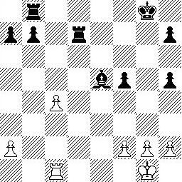
Evaluation Function for Chess
Piece values:
pawn=1, horse=bishop=3,
castle=5, queen=9
Black:
5 pawn, 1 bishop, 2 castle
Score = 1*(5)+3*(1)+5*(2)
= 5+3+10 = 18
White:
5 pawn, 1 castle
Score = 1*(5)+5*(1)
= 5 + 5 = 10
Scores of the two sides in this state:
for black= 18-10 = 8
for white= 10-18 = -8
Notes:
Satrançta Sınırlar
Arama uzayının büyüklüğü (32⁴⁰)
Ortalama hamle sayısı = 40
Her adımda yapılabilecek farklı hamle sayısı ortalaması = 32
32⁴⁰ = 2²⁰⁰ ~= 10⁶⁰
Saniyede 3 milyar durum işlersek
Bir yıldaki saniye sayısı ~= 32*10⁶
Bir yılda işlenecek durum sayısı ~= 10¹⁷
Tüm durumların değerlendirilmesi 10⁴³ yıl sürer.
Evrenin yaşı ~= 10¹⁰ yıl
Sınırları Aşmak İçin
Sınırlı Derinlikte Arama ve değerlendirme fonksiyonu (cutoff test, evaluation function)
Alfa beta budaması

Slide 24
Evaluation Function for Chess
Main task is to determine f and w values:
Pawns with empty surrounding are bad.
Does the king have guardians?
How is your movement ability?
Do you have the control of the board center?
Do w’s change values during the game?

Slide 25
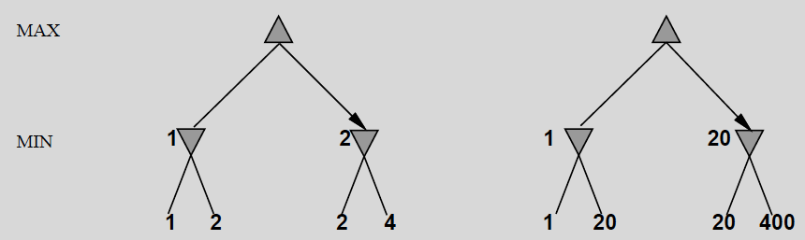
Digression: Exact Values Don’t Matter
Behaviour is preserved under any monotonic transformation of Eval
Only the order matters:
payoff in deterministic games acts as an ordinal utility function
Notes:
Digression: Ara söz
Ordinal: sıra belirten

Slide 26
Cutting off Search
Does it work in practice?
Suppose we have 100 secs, explore 10⁴ nodes/sec then b^{m} is limited by 10⁶
if b=35 → m=4
4-ply lookahead is a hopeless chess player!
4-ply ≈ human novice
8-ply ≈ typical PC, human master
12-ply ≈ Deep Blue, Kasparov
α-β reaches depth 8 (pretty good chess program)
Notes:
Çözüm: Sınırlı derinlikte aramaya alfa beta budama eklemek
Novice: acemi, amatör

Slide 27
Alpha-Beta Pruning
Improves the performance of the minimax algorithm through alpha-beta pruning
Basic idea: “If you have an idea that is surely bad, don't take the time to see how truly awful it is.” -- Pat Winston
MAX
>=2
No need to compute the value at this node.
No matter what it is, it can’t affect the value of the root node.
MIN
=2
<=1
MAX
2
7
1
?

Slide 28
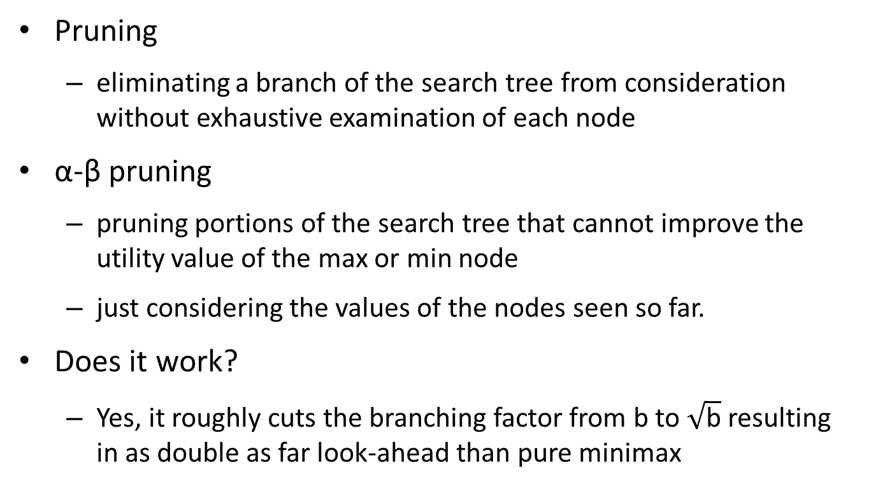
Alpha-Beta Pruning Search Cut-off
Pruning
eliminating a branch of the search tree from consideration without exhaustive examination of each node
α-β pruning
pruning portions of the search tree that cannot improve the utility value of the max or min node
just considering the values of the nodes seen so far.
Does it work?
Yes, it roughly cuts the branching factor from b to $\sqrt{\text{b}}$ resulting in as double as far look-ahead than pure minimax

Slide 29
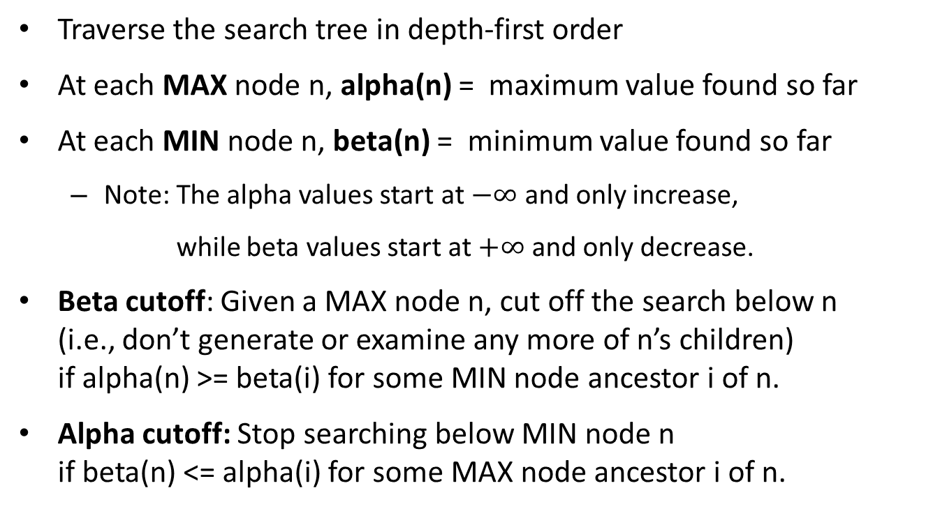
Alpha-Beta Pruning
Traverse the search tree in depth-first order
At each MAX node n, alpha(n) = maximum value found so far
At each MIN node n, beta(n) = minimum value found so far
Note: The alpha values start at $−∞$ and only increase,
while beta values start at $+∞$ and only decrease.
Beta cutoff: Given a MAX node n, cut off the search below n (i.e., don’t generate or examine any more of n’s children) if alpha(n) >= beta(i) for some MIN node ancestor i of n.
Alpha cutoff: Stop searching below MIN node n if beta(n) <= alpha(i) for some MAX node ancestor i of n.

Slide 30
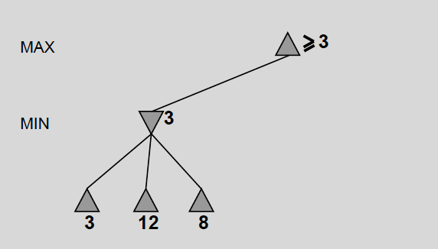
α-β Pruning Example

Slide 31
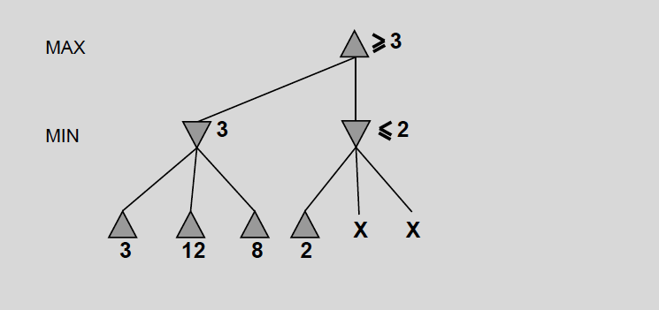
α-β Pruning Example

Slide 32
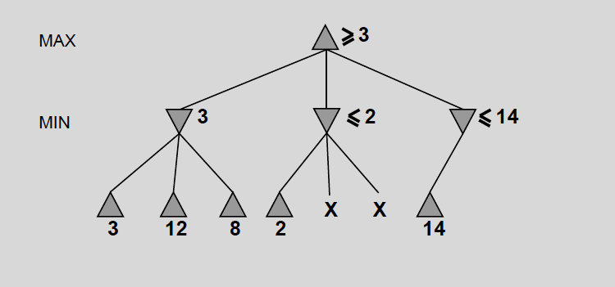
α-β Pruning Example

Slide 33
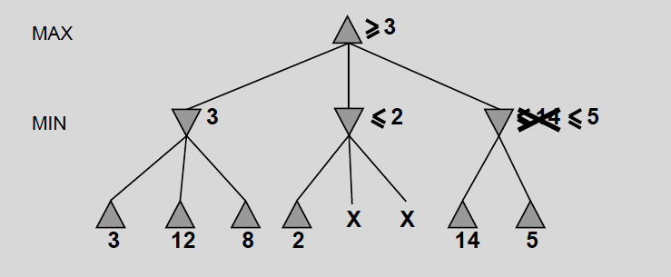
α-β Pruning Example

Slide 34
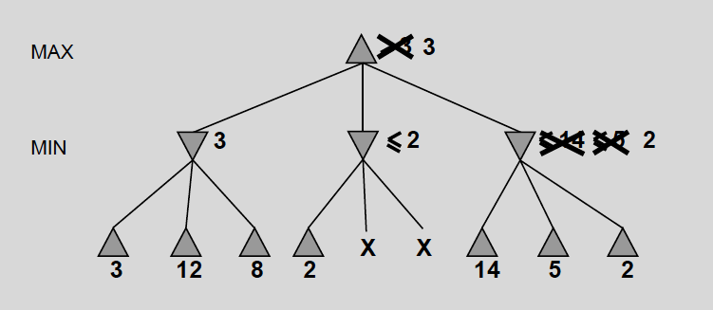
α-β Pruning Example

Slide 35
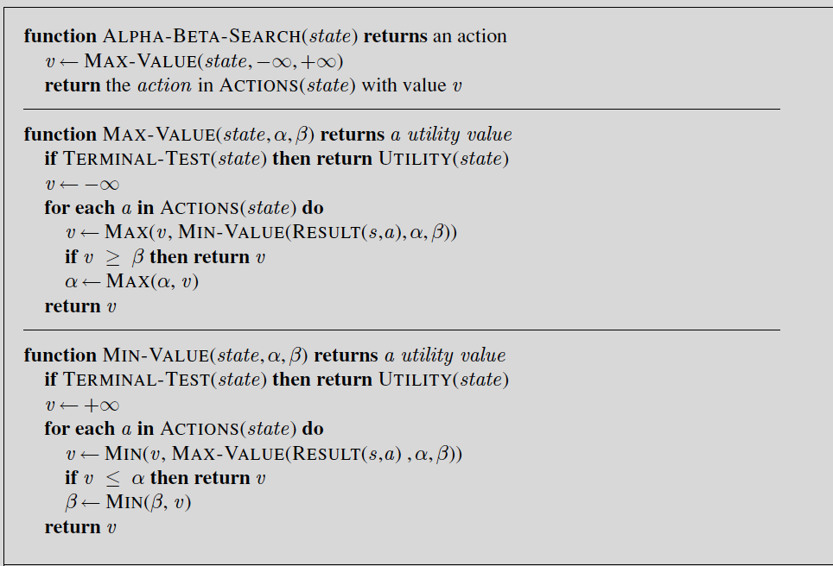
The α-β Algorithm
β Cutoff
α Cutoff

Slide 36
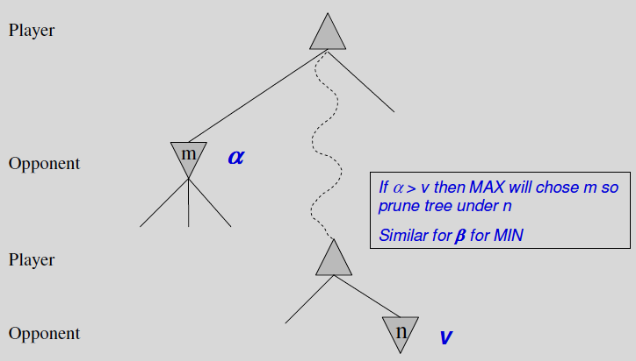
α-β Pruning: General Principle

Slide 37
Effectiveness of Alpha-Beta
Pruning does not affect final result
Alpha-beta is guaranteed to compute the same value for the root node as computed by minimax, with less or equal computation
Worst case: no pruning, examining O(b^{d}) leaf nodes, where each node has b children and a d-ply search is performed
Best case: examine only O(b^{(d/2)}) leaf nodes.
Result is you can search twice as deep as minimax!
Occurs when each player’s best move is generated first among the alternatives
Good move ordering improves effectiveness of pruning
In Deep Blue, they found empirically that with alpha-beta pruning the average branching factor at each node was about 6 instead of about 35!

Slide 38
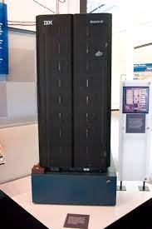
Games–History of Chess Playing
• 1949 – Shannon paper – originated the ideas
• 1951 – Turing paper – hand simulation
• 1958 – First computer that played chess, IBM 704
• 1955-1960 – Simon-Newell program
• 1961 – Soviet program
• 1966 – 1967 – MacHack 6 – defeated a good player
• 1970s – NW chess 4.5
• 1980s – Cray Bitz
• 1990s – Belle, Hitech, Deep Thought,
• 1997 – Deep Blue - defeated Garry Kasparov
• 2008 – Stockfish, the world's strongest CPU chess engine
• 2017 – AlphaZero- defeated Stockfish
(scoring 28 wins, 72 draws, and zero losses)

Slide 39
Deterministic Games in Practice
Checkers:
Chinook ended 40-year-reign of human world champion Marion Tinsley in 1994.
Used a precomputed endgame database defining perfect play for all positions involving 8 or fewer pieces on the board, a total of 444 billion positions.
Chess:
Deep Blue defeated human world champion Garry Kasparov in a six-game match in 1997.
Deep Blue searches 200 million positions per second, uses very sophisticated evaluation, and extends some lines of search up to 40 ply.
AlphaZero searches just 80,000 positions per second in chess compared to 70 million for Stockfish,
compensates for the lower number of evaluations by using its deep neural network to focus much more selectively on the most promising variation
Notes:
Endgame: final maçı

Slide 40
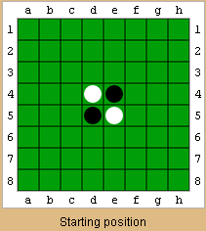
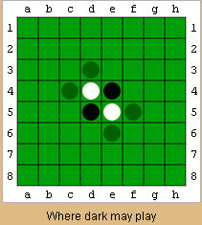
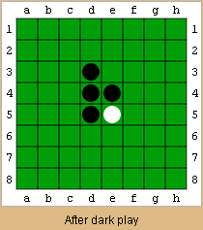
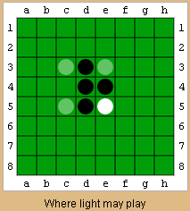
Deterministic Games in Practice
Othello:
Human champions refuse to compete against computers, who are too good.

Slide 41
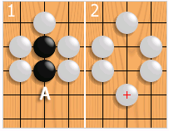
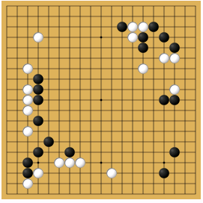
Deterministic Games in Practice
Go:
Formerly human champions refuse to compete against computers, who are too bad.
In go, b is 361 on a 19x19 play board.
In March 2016, AlphaGo defeated world champion Lee Sedol 4:1 running on 48 TPUs, distributed.
In October 2017, AlphaGo Zero defeated AlphaGo 100:0 running on 40 blocks, 4 TPUs, single machine.
In December 2017, AlphaZero defeated AlphaGo Zero 60:40 running on 20 blocks, 4 TPUs, single machine.
AlphaZero is a more generalized variant of the AlphaGo Zero algorithm, and is able to play shogi and chess as well as Go.
AlphaGo's algorithm uses a combination of
machine learning and tree search techniques,
combined with extensive training, both from human and computer play.
Monte Carlo tree search, guided by a value network and a policy network, both implemented using deep neural network technology.
Notes:
Differences between AZ and AGZ include:^{[1]}
AZ has hard-coded rules for setting search hyperparameters.
The neural network is now updated continually.
AZ doesn't use symmetries, unlike AGZ.
Chess can end in a draw unlike Go; therefore, AlphaZero takes into account the possibility of a drawn game.

Slide 42
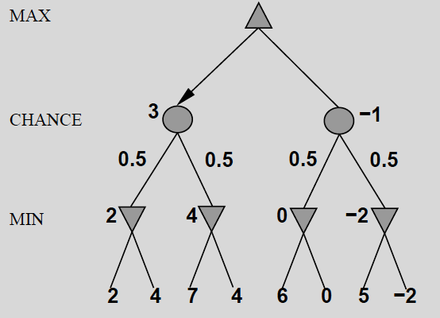
Nondeterministic Games
In nondeterministic games, chance introduced by
dice or card-shuffling
Simplified example with coin-flipping:

Slide 43
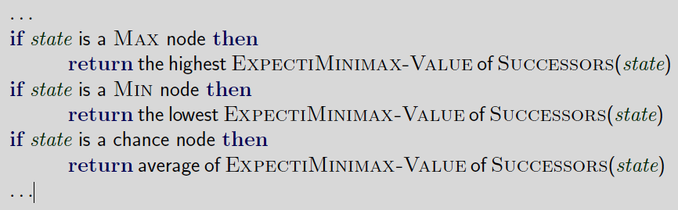
Algorithms for Nondeterministic Games
Expectiminimax gives perfect play
Just like Minimax, except we must also handle chance nodes:

Slide 44
Expectiminimax Evaluation of Nodes
EXPECTIMINIMAX(n) =
If n is terminal node→ UTILITY(n)
If n is max node→ max ( Successors(n) )
If n is min node → min( Successors(n) )
If n is chance node→ ∑ P(s) * Successors(n)
States that may occur with dices or cards are ordered according to their probabilities
For example, 21 different chance nodes are possible for two dices in backgammon (6 double dices, 15 different dices).
Notes:
1 1 1/36
2 1,1 2 2

Slide 45
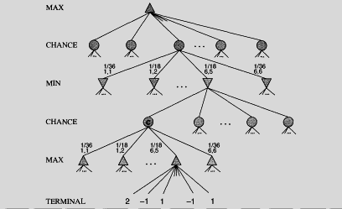
Expectiminimax
My possible moves
Opponent’s rolled dices
Opponent’s possible moves
My rolled dices
My possible moves

Slide 46
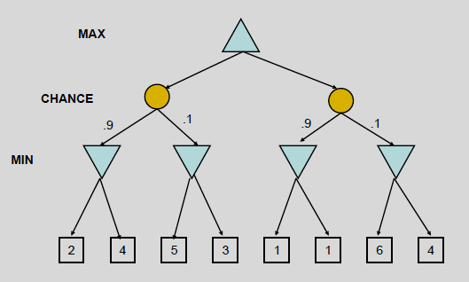
Expectiminimax Example
My possible moves
Opponent’s rolled dices
Opponent’s possible moves
State scores according to me

Slide 47
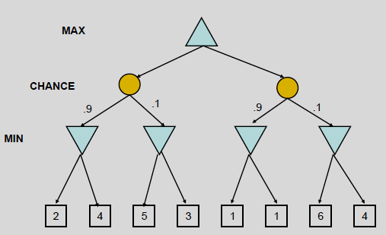
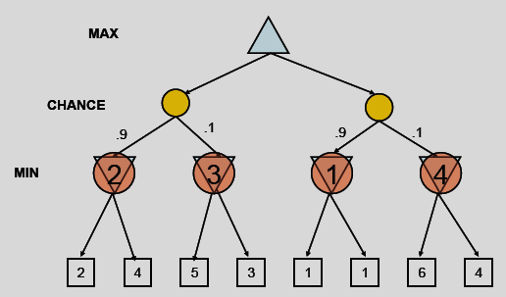
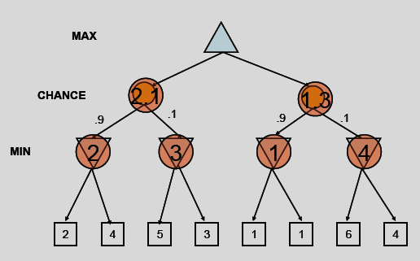
Expectiminimax Example

Slide 48
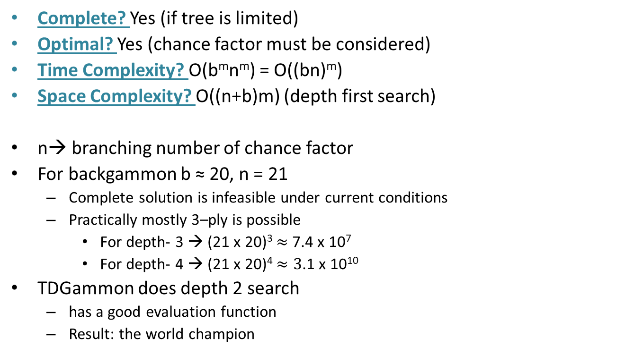
Expectiminimax Evaluation
Complete? Yes (if tree is limited)
Optimal? Yes (chance factor must be considered)
Time Complexity? O(b^{m}n^{m}) = O((bn)^{m})
Space Complexity? O((n+b)m) (depth first search)
n→ branching number of chance factor
For backgammon b ≈ 20, n = 21
Complete solution is infeasible under current conditions
Practically mostly 3–ply is possible
For depth- 3 → (21 x 20)³ $≈$ 7.4 x 10⁷
For depth- 4 → (21 x 20)⁴ $≈3$.1 x 10¹⁰
TDGammon does depth 2 search
has a good evaluation function
Result: the world champion

Slide 49
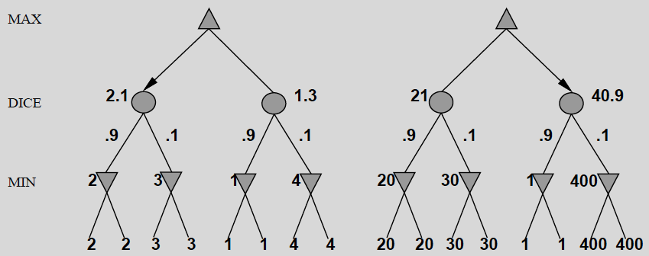
Digression: Exact Values DO Matter
Behaviour is preserved only by positive linear transformation of EVAL
Hence EVAL should be proportional to the expected payoff

Slide 50
Games with Imperfect Information
For example card games, where opponent's initial cards are unknown
Typically we can calculate a probability for each possible deal
Seems just like having one big dice roll at the beginning of the game
Idea: compute the minimax value of each action in each deal, then choose the action with highest expected value over all deals
Special case: if an action is optimal for all deals, it's optimal.
GIB, once the best bridge program, approximates this idea by
1) generating 100 deals consistent with bidding information
2) picking the action that wins most tricks on average

Slide 51
Proper Analysis
Intuition that the value of an action is the average of its values in all actual states is WRONG
With partial observability, value of an action depends on the information state or belief state the agent is in
Can generate and search a tree of information states
Leads to rational behaviors such as
Acting to obtain information
Signalling to one's partner
Acting randomly to minimize information disclosure

Slide 52
Prediction and Learning
Computers can
record logs of user actions.
predict user actions depending on these logs.
do the best action according to these predictions
Then there is no need to consider all contingencies
For example:
Previous actions
Low Kick, Low Punch, Uppercut 10 50%
Low Kick, Low Punch, Low Punch 7 35%
Low Kick, Low Punch, Low Kick 3 15%
Current state:
Low Kick, Low Punch, ?

Slide 53
Learning the Evaluation Function
Deep Blue has learned the weights (w_{1,} w_{2,..} ,w_{n}) in the evaluation function
f(p) = w₁f₁(p) + w₂f₂(p) + ... + w_{n}f_{n}(p)
How?

Slide 54
Learning the Evaluation Function
A database of «did that in this state» is recorded in more than 1000 games of grand-master-level players including their every move
For every move, w’s are reorganized such that
the evaluation function f(p) is maximized for the performed action in the database from among the possible actions from current state to the next states.

Slide 55
Summary
Games illustrate several important points about AI
Perfection is unattainable -> approximation
Gives practical idea what to consider in AI problems
Uncertainty constrains the assignment of values to states
Games are to AI as grand prix racing is to automobile design

